Slide 1
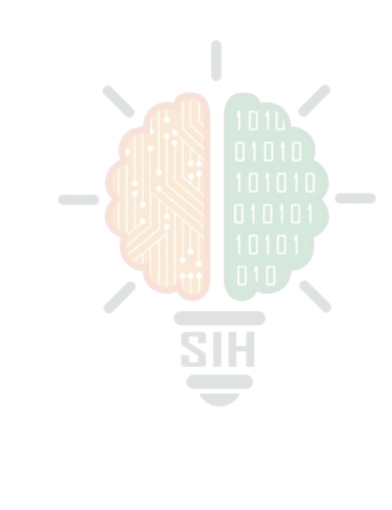
SMART INDIA HACKATHON 2026
AYUSHMAN BHARAT DIGITAL MISSION
Problem Statement ID - SIH26047
PS Title - Patient-Case Taking Software
Theme - MedTech / Bio Tech / HealthTech
PS Category - Software/Hardware
Team ID -
Team Name – Silicon Squad

Slide 2







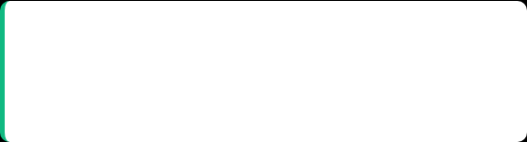
MediSaarthi
THE PROBLEM & OUR PROPOSED SOLUTION
The Problem
Proposed Solution
Time Constraint
Automated Intake (AarogyaLink)
India's median OPD consultation is just 2 minutes. Doctors waste valuable time transcribing symptoms instead of diagnosing.
Captures multilingual voice histories in the waiting room, mapping red-flag keywords to a 1-10 severity scale.
Fragmented Data
Clinical Drafts
Patient histories are scattered across paper files, leading to disorganized medical details and incomplete context.
Instantly generates ABDM-compliant clinical drafts, eliminating manual transcription and freeing doctors to focus purely on diagnosis.
Adherence Blind Spots
Closed-Loop Tracking
Post-consultation medication adherence is completely invisible to the hospital, preventing effective follow-up care.
India's first system where an IoT API pushes digital prescriptions to a paired Smart Medicine Box for real-time remote adherence tracking.

Slide 3

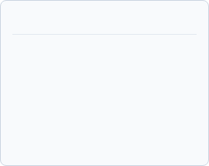

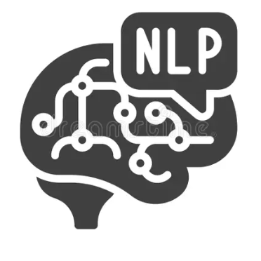
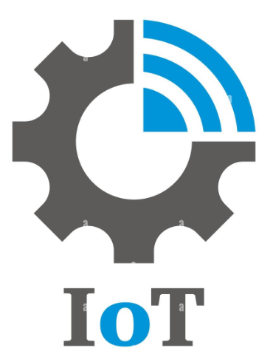

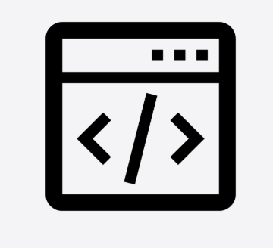


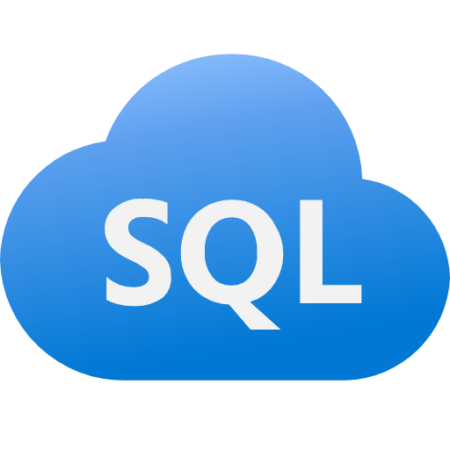






MediSaarthi
TECHNICAL APPROACH
TECHNOLOGY STACK & HARDWARE
CORE MODULES
NLP Triage Engine
IoT API Extension
Maps user voice inputs (e.g., "stomach pain") directly to SNOMED-CT clinical terms and Ayush parameters (Prakriti, Diet, Sleep) for accurate analysis.
Pairs website with Smart Medicine Box via Unique Device UUID. Establishes a highly secure MQTT / WebSocket bridge for real-time synchronization.
Frontend Core
React / Next.js Web App
Frontend
Front end
Backend API
Smart
medicine system
Python / Flask Backend
database
Backend API
Database
PostgreSQL
SYSTEM FLOW (END-TO-END)
Edge Hardware
Edge hardware
ESP32-S3, ESP32-CAM, Ultrasonic Sensor (HC-SR04), SIM900A GSM
Step 1: Intake
Step 2: Review
Step 3: API Sync
Step 4: Verify
Voice Symptom Intake via Web App → NLP Engine
Doctor reviews auto-draft & issues Digital Prescription
Web App API syncs active slots to Smart Medicine Box
Hardware sends photo evidence & timestamp back to Dashboard

Slide 4


MediSaarthi
FEASIBILITY AND VIABILITY
Technical Feasibility
Economic Viability
Operational Viability
Proven technologies: React, Python, AI, OCR & Speech Recognition.
Open-source technologies significantly reduce initial development and licensing costs.
Fits naturally and seamlessly into the existing clinical pre-consultation workflow.
AI effectively collects and structures complex patient history accurately.
Cloud deployment enables a highly scalable, pay-as-you-use server infrastructure.
Reduces repetitive history-taking, saving significant time for attending doctors.
Digital scanning converts physical medical documents into usable, searchable data.
Saves valuable consultation time, directly improving overall hospital resource utilization.
Doctor acts as the ultimate authority, verifying and approving the AI-generated summary.
Secure digital storage enables highly organized and safe medical records management.
Highly scalable business model, adaptable from small clinics to massive hospital networks.
Voice, touchscreen & multilingual interactions vastly improve patient accessibility.

Slide 5
MediSaarthi
Our Edge Over Existing Solutions
COMPETITIVE ADVANTAGE MATRIX
INNOVATION & UNIQUENESS
Feature Area | Existing EMRs & Consumer Pillboxes | MediSaarthi (Our Solution)
System Scope | Isolated. Software stops at digital registration. Hardware only provides standalone reminders. | Closed-Loop. Links pre-consultation case-taking directly to post-care home tracking.
Pre-Consult Input | English-only text typing or manual paper transcription by hospital staff. | Multilingual Voice AI (Bhashini) with automated NLP entity and symptom extraction.
Hardware Sync | None. Doctors have absolutely zero visibility into home adherence data. | Direct IoT API Sync. UUID-paired edge device syncs schedules instantly from the doctor's EMR.
Verification | Blind trust or manual "Mark as Taken" app buttons (easily faked or forgotten). | Physical verification via ESP32-CAM & Sensor + automated Caregiver GSM alerts.
1. Zero-Friction Pairing:
Eliminates complex IT integration. Pairs the web portal directly to the hardware using a simple 6-digit UUID over Wi-Fi/MQTT.
2. Voice-First Triage:
Integrates Bhashini AI for multilingual voice intake. Calculates severity (1-10) and auto-routes patients before they enter the cabin.
3. Dual-Medicine Standards:
Fully ABDM/FHIR compliant while uniquely capturing AYUSH baselines (Prakriti, Diet, Sleep) for a comprehensive clinical draft.
4. Triple-Layer Tracking:
Replaces manual app buttons with physical dose verification (Camera + Sensor), backed by offline RTC alarms and GSM SMS alerts.

Slide 6



MediSaarthi
IMPACT AND BENEFITS
Doctors: Saves up to 60% of history-taking time per patient, allowing focus on direct clinical examination.
Full alignment with the Ayushman Bharat Digital Mission (ABDM).
Significantly reduces hospital wait times and alleviates severe OPD congestion.
Patients: Voice-first UI helps low-literacy users. Smart reminders prevent missed doses and accidental double-dosing.
Patient data is natively exported in standard FHIR JSON formats.
Improves national health outcomes across various demographics.
Caregivers: Receive real-time SMS/Call escalations immediately if a critical dose is missed.
System architecture is fully ready for seamless ABHA ID linkage.
Shifts the care paradigm from passive prescription to active adherence monitoring.

Slide 7

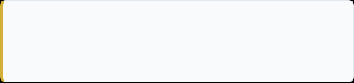

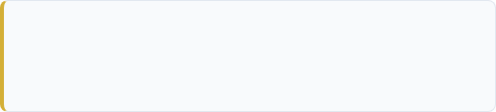

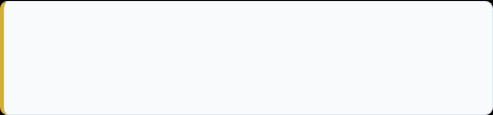
MediSaarthi
RESEARCH, ANALYSIS & REFERENCES
Project Analysis
Supporting References
Gap & Problem Identification
Current case-taking solutions stop at digital registration. None bridge the gap between pre-consultation symptom capture and post-consultation medication adherence.
WHO Digital Health Guideline: WHO recommendations on digital interventions for health system strengthening.
https://www.who.int/health-topics/digital-health
WHO AI in Healthcare Guidance:
https://www.who.int/publications/i/item/9789240029200
Survey & Competitive Analysis
ABDM & FHIR Compliance: Ayushman Bharat Digital Mission (ABDM) official guidelines for interoperability.
Basic hospital chatbots cannot generate structured clinical drafts for doctors.
MediSaarthi uses dynamic NLP to adapt questions based on patient responses and links output to hardware tracking.
https://www.nrces.in/preview/ndhm/fhir/r4/index.html
Field Tests & Simulation Results
Multilingual Voice Intake (Bhashini): National Language Translation Mission APIs used for regional language voice-to-text.
Prototype validated across 3 guided languages.
https://bhashini.gov.in/?utm_source=chatgpt.com
Hardware successfully synced 5 medicine slots dynamically from the web portal and recorded 30 consecutive dose-history logs.

